Slide 1

DIVIDING AN AMOUNT INTO RATIOS
Key Concepts
A woman has £400. She is going to split her money between her two children in the ratio 2:3. How much does each child receive?
: 3
400 ÷ 5
= 80
Child 1 receives £160 and Child 2 receives £240.
There are boys and girls at a party in the ratio 5:2.
There are 15 more boys than girls. Calculate the number of people at the party.
5 : 2
15 ÷ 3
= 5
7 × 5
= 35 people
An amount can be divided into a given ratio.
Red : Green
1 : 3
For every 1 red there are 3 greens.
A ratio can be converted into fractions.
Red : Green
1 : 3
$\frac{1}{4}$ are red and $\frac{3}{4}$ are green.
No. of boxes
(2+3)
No. of extra
Boxes (5-2)
80
80
5
5
80
80
5
5
£160
80
5
£240
5
5
Examples
Ann made some cakes. She made vanilla cakes and chocolate cakes in the ratio 2:9. What fraction of the cakes were chocolate?
Share £25 in the ratio 7:3
3) Katy and Becky share some money in the ratio 2:1. Katy receives £10 more than Becky. How much do they each receive?
4) Claire and John share some money in the ratio 3:2. Claire receives £18. How much does John receive?
Key Words
Ratio
Divide
Parts
329, 330, 332-337
ANSWERS 1) $\frac{9}{11}$ 2) £17.50, £7.50 3) £20, £10 4) £12

Slide 2
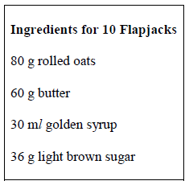
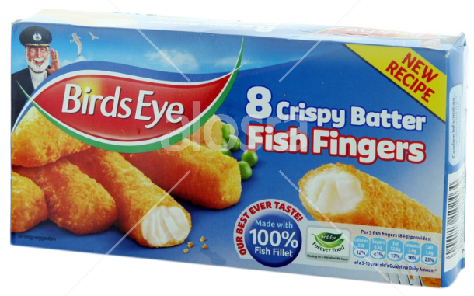
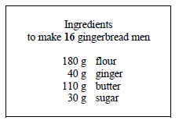



RATIO AND DIRECT PROPORTION
Key Concepts
Examples
The recipe shows the ingredients needed to make 10 Flapjacks.
How much of each will be needed to make 25 flapjacks?
If 20 apples weigh 600g. How much would 28 apples weigh?
600 ÷ 20 = 30g weight of 1 apple
30 × 28 = 840g
To calculate the value for a single item we can use the unitary method.
When working with best value in monetary terms we use:
$$Price per unit=\frac{price}{quantity}$$
In recipe terms we use:
$$Weight per unit=\frac{weight}{quantity}$$
Method 1: Unitary
80 ÷ 10 = 8
8 × 25 = 200g
60 ÷ 10 = 6
6 × 25 = 150g
30 ÷ 10 = 3
3 × 25 = 75g
36 ÷ 10 = 3.6
3.6 × 25 = 90g
Box A has 8 fish fingers costing £1.40.
Box B has 20 fish fingers costing £ 3.40.
Which box is the better value?
$$A=\frac{£1.40}{8}$$
$=£0.175$
$$B=\frac{£3.40}{20}$$
$=£0.17$
Method 2: 5 flapjacks
80 ÷ 2 = 40
40 × 5 = 200g
60 ÷ 2 = 30
30 × 5 = 150g
30 ÷ 2 = 15
15 × 5 = 75g
36 ÷ 2 = 18
18 × 5 = 90g
Therefore Box B is better value as each fish finger costs less.
Key Words
Unitary
Best Value
Proportion
Quantity
2) Packet A has 10 toilet rolls costing £3.50.
Packet B has 12 toilet rolls costing £3.60.
Which is better value for money?
3) If 15 oranges weigh 300g. What will 25 oranges weigh?
1) How much will we need to make 24 gingerbread men?
335-337
ANSWERS 1) 270g flour, 60g ginger, 165g butter, 45g sugar 2) Packet B 30p per roll 3) 500g

